Slide 1



Arduino 5 – temperature
Steven hammer
s.hammer@hw.ac.uk

Slide 2
introduction
Use an Arduino and a temperature sensor to measure temperature
Log the data and plot it in Excel

Slide 3
What are we doing today?
Create a circuit with a temperature sensor
Measure temperature and log it to the serial window
Copy/paste and send to Excel for graphing

Slide 4
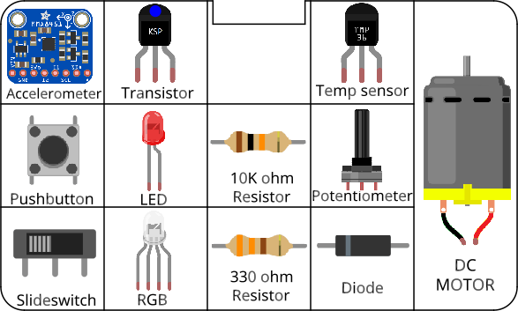
Circuits
All components included in the kit…

Slide 5
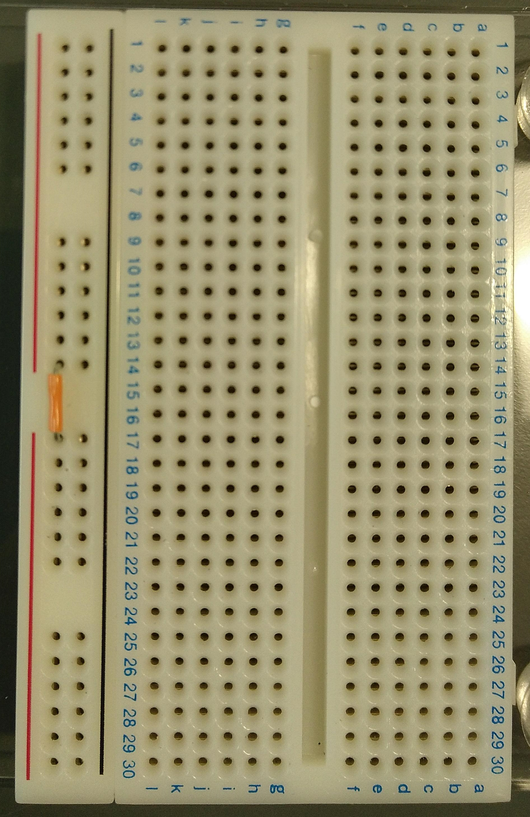
Before you start Building circuits…
Connect power bus (+ line) together using a small section of jumper cable

Slide 6
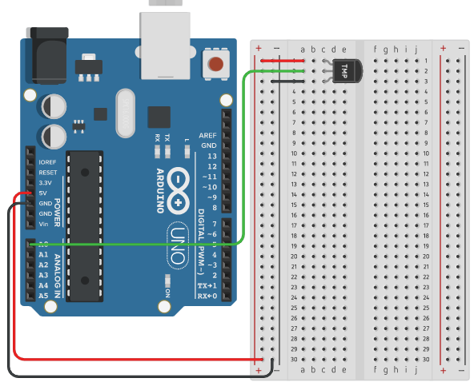
Building circuits
Insert components into breadboard holes
Connect up using instrument wire
Arduino controls inputs and outputs
Follow schematics
NOTE: GND = negative

Slide 7
Debugging code
Is there a space missing somewhere?
Do all lines end with a semicolon;
Is something commented out //

Slide 8
housekeeping
Work in pairs
Take two boxes per pair:
One Arduino box
One Sensors and Motion kit
Cut your own (single core) instrument wire
Put components back into labelled places in boxes after use
Any components missing – let us know.

Slide 9
TIDYING up
Return components to your Sensors and Motion box IN THE CORRECT PLACES!!!
Put instrument wire in motor compartment
Return Arduino to its case
Return both boxes to tutor

Slide 10
Finished already?
Add a timestamp to each measurement in the Arduino code (not just the serial monitor timestamp)
Turn on a fan (servomotor) when the measured temperature goes above a chosen level
Log when the fan is switched on along with the measured temperature
Change the colour of an RGB LED to match the measured temperature (blue = cold, orange = medium, red = hot)

